Slide 1
IcedHops: Reducing Read and Write Latency in an Iceberg-Backed Offline Feature Store
3rd April 2025
Sebastiano Meneghin – sebastiano.meneghin@mail.polimi.it

Slide 2

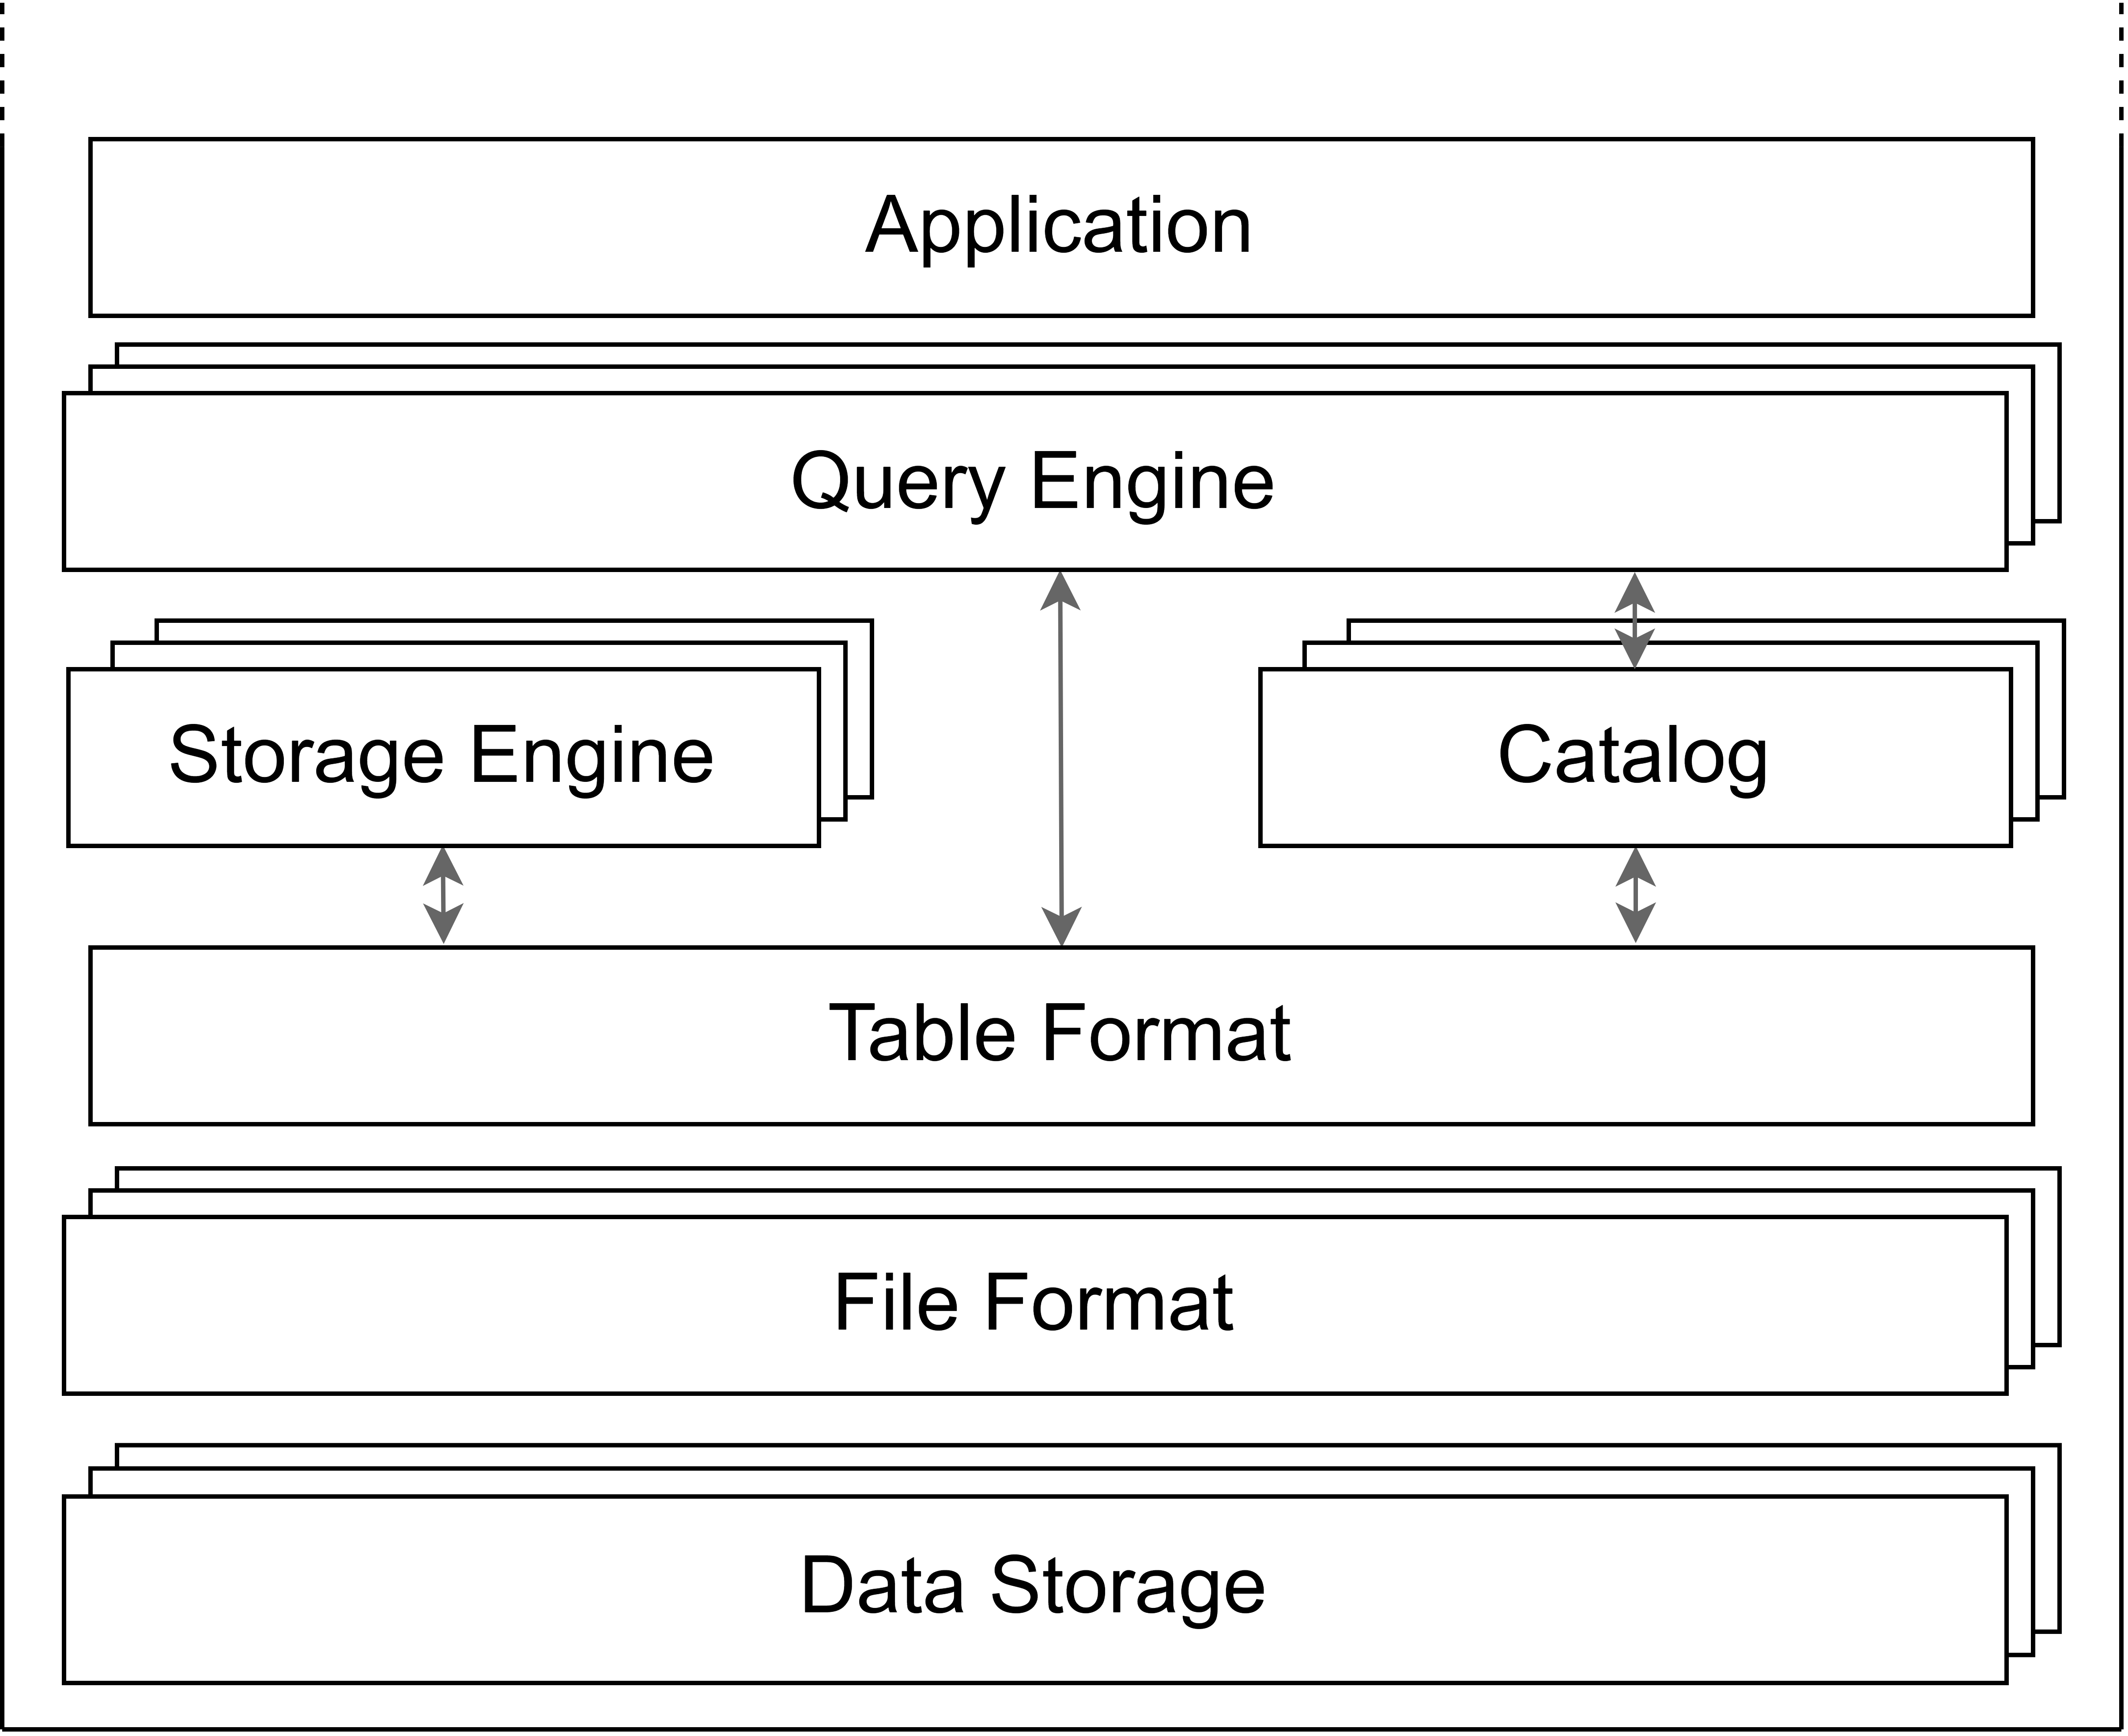
What is a data lakehouse?
Data lake + Data warehouse
Supports:
All data types
ACID properties
Interoperability
Notes:
Emerged in 2017, a data lakehouse integrate structure ad unstructured data storage capabilities of data lakes, while maintaining the governance, the ACID compliance, and the analytics capabilities of a data warehouse.
It enables organizations to use a single storage for all the types of data, while supporting high-performance SQL queries, as well as ML workloads.
By their design, several data lakehouses ensure interoperatbility with various query engines, table formats and file formats, avoiding the risk of getting data locked into a proprietary solution.

Slide 3
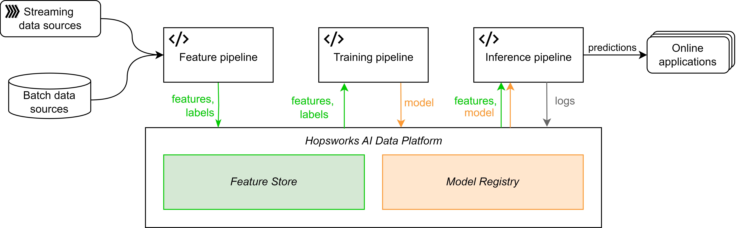
What is a feature store?
Data versioning for ML pipelines
Enable feature reusability
Usually coupled with a model registry

Slide 4
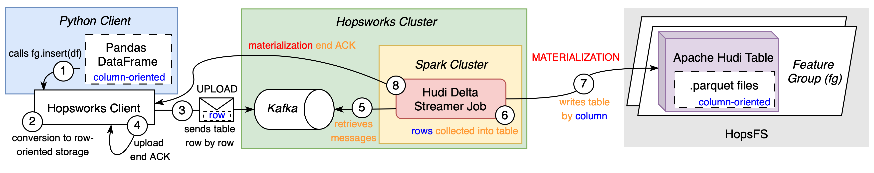
Hopsworks offline feature store - Writing
[1] De La Rúa Martínez, Javier, Fabio Buso, Antonios Kouzoupis, Alexandru A. Ormenisan, Salman Niazi, Davit Bzhalava, Kenneth Mak, et al. 2024. “The Hopsworks Feature Store for Machine Learning.” SIGMOD/PODS ’24: Companion of the 2024 International Conference on Management of Data, May. https://doi.org/10.1145/3626246.3653389.
[2] https://docs.hopsworks.ai/latest/
Notes:
The current writing operation on the legacy Hudi-based system, is quite complex.
There are three tiers involved, the Python client, the Hopsworks cluster, and HopsFS.
The Python client is where the Hopsworks API is used to read and write data on the underlying system. When data are sent via the network, are converted from column oriented formats to row oriented. Each row is uploaded on Kafka, as a single message. Then the Hudi delta streamer, a Spark job triggered with a specified recurrency, takes those rows from the dedicated Kafka topics and “materialize” them in the Hudi tables saved on HopsFS.

Slide 5
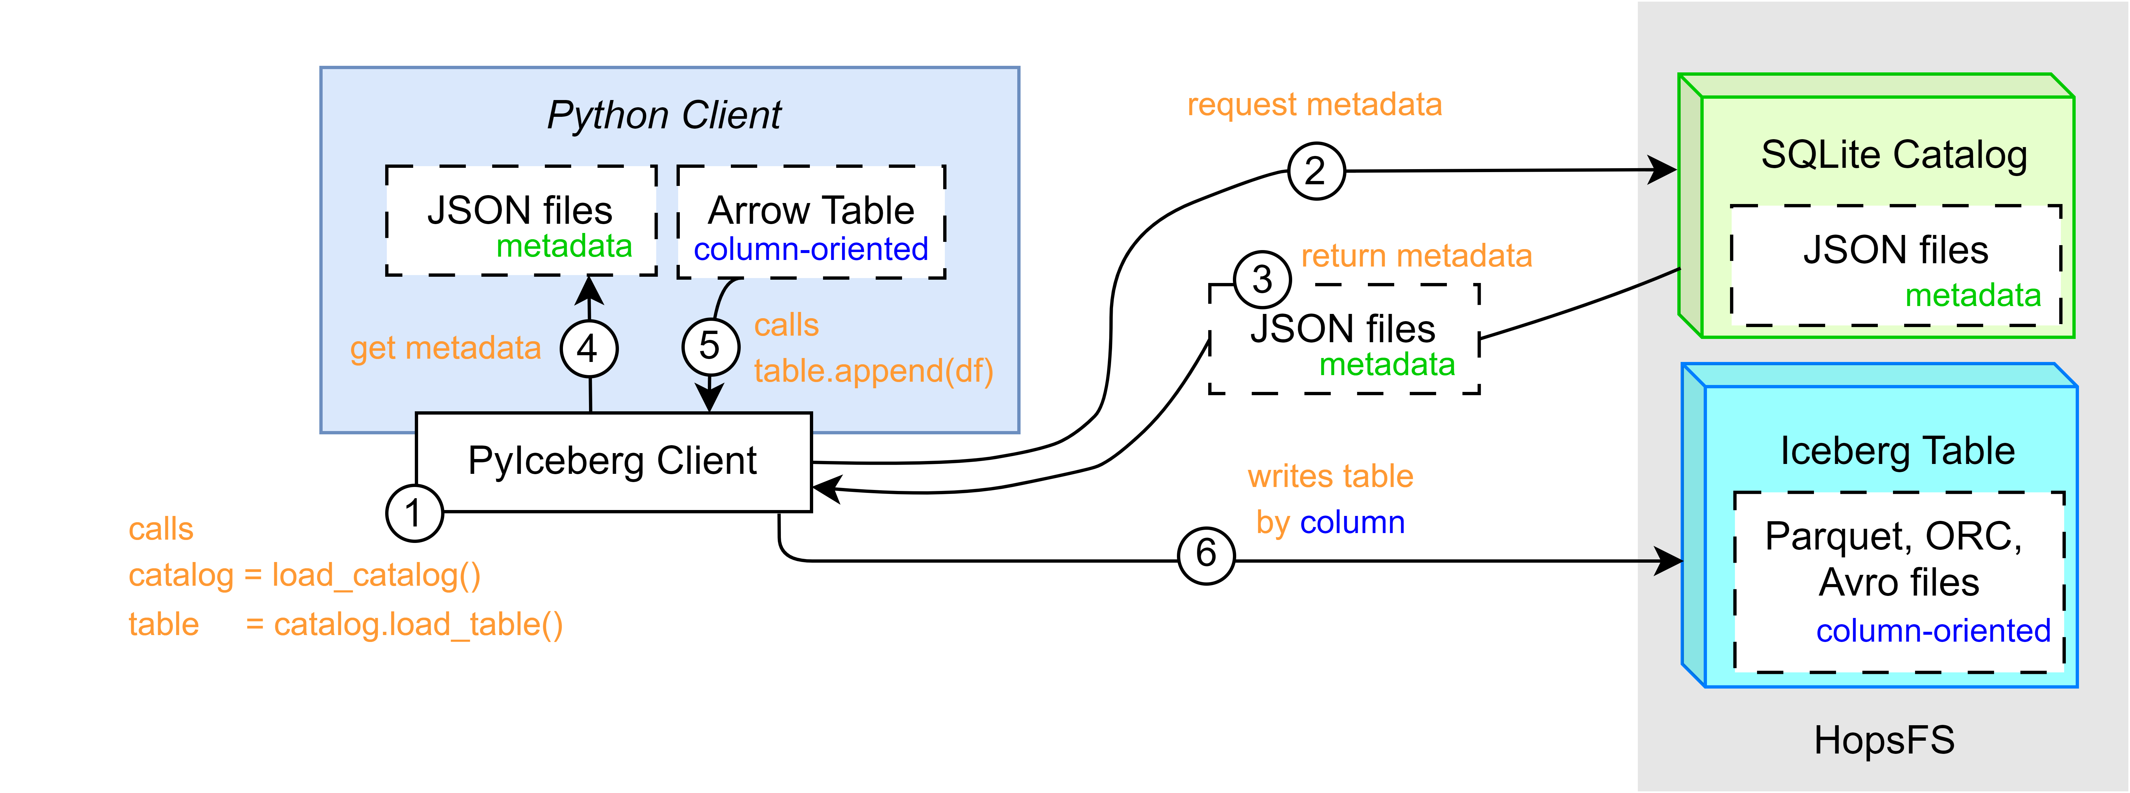
IcedHops - Writing
5
Notes:
IcedHops, the new system based on PyIceberg, aims at streamlining the read operation by:
- Removing the middle-tier, consisting on Kafka and Hudi delta streamer
- Providing column-based transfer, avoiding thus format-conversion and serialization overheads.
- Removing Spark for the equation
However, the integration PyIceberg and HopsFS… did not exist

Slide 6
Research Questions
RQ1: possible to integrate IcedHops?
Differences in read and write latency and throughput on the Hopsworks offline feature store, between the:
RQ2: legacy system and IcedHops
RQ3: IcedHops and the delta-rs system

Slide 7
Methodology
System integration
System evaluation
aaaaaaaaaaaaaaaaaa
System evaluation
RQ1: possible to integrate IcedHops?
Differences in read and write latency and throughput on the Hopsworks offline feature store, between the:
RQ2: legacy system and IcedHops
RQ3: IcedHops and the delta-rs system

Slide 8
IcedHops – Design choices (4/7)
Hopsworks
Iceberg
HopsFS
HopsFS + Iceberg
Notes:
The storage engine is the part of the data lakehouse architecture which handles the data management tasks, aimed at optimizing efficiency of queries over the data. It generally performs data compation, indexing and partitioning. In this specific case, Iceberg already takes care of this for the metadata layer, while the HopsFS handles those operations on the physical layer, or data layer. Thus, no other specific technologies needed to be plugged in.

Slide 9
IcedHops – Design choices (5/7)
Avro
ORC
Parquet
Hopsworks
HopsFS + PyIceberg
Iceberg
HopsFS
Notes:
In this context, HopsFS is agnostic of the kind of files saved on the top of it. Iceberg support three different column-based file format, which are Avro, ORC, and Parquet. While Hudi, supports the three of them as well, Delta Lake only support Parquet.
Thus, to allow a fair comparison of the three systems, Parquet has been chosen for the experiments conducted on this system. However, IcedHops, already support those three file formats.

Slide 10
IcedHops – Design choices (6/7)
AWS Athena
Snowflake
Spark
Presto
Trino
Flink
DuckDB [4,5]
Hopsworks
HopsFS + PyIceberg
Iceberg
Parquet
HopsFS
[4] Khazanchi, 2023. ”Faster reading with DuckDB and Arrow Flight on Hopsworks: benchmark and performances evaluation of offline feature stores”. KTH, Royal Institute of Technology
[5] Rassveldt, Muhleisen. ”DuckDB: An Embeddable Analytical Database” in Proceedings of the 2019 International Conference on Management of Data, SIGMOD 19..
Notes:
PyIceberg support several Query Engines, despite this being less than the one supported by other Iceberg libraries (for example the Java ones).
AWS Athena, and Snowflake, has been discarded a-priori, as they are proprietary solutions, and would have thus lowered the reproducibility of the experiments, as well as accounting to additional costs.
Spark was discarded as directly violating the purpose of this project, which is creating a Spark free alternative
Presto, Trino and Flink, were discared since, as Spark, are designed to perform their best in large-scale data scenarios. Furthermore, being complex system, did not fulfil the maintainability not-functional requirements described before.
Duck, was the final choice, as it is a portable open-source OLAP-DBMS, which also proved to be the best performing engine in related work on small-scale scenarios.

Slide 11
IcedHops – Design choices (7/7)
REST
AWS Glue
AWS DynamoDB
Hive MS
SQL Catalog
Hopsworks
DuckDB
HopsFS + PyIceberg
Iceberg
Parquet
HopsFS
Notes:
The Catalog keeps track of information about each table (name, column, data types) and a reference of the metadata for each table (depending on the table format).
A REST catalog is by design the most integrable solution and thus is supported by HopsFS. However, this does not fulfil the maintainability requirements, as it should be built from scratch.
AWS Glue and DynamoDB, as proprietary solutions, has been discarded a-priori, following the same reasoning of the discarded prioprietary query engines.
Hive Metastore is supported by HopsFS. However, it is a complex tool, initially developed to by tightly integrated with MapReduce and Spark environments and perhaps perform its best in large-scale data scenarios.
SQL Catalog, it is supported by HopsFS and it could be instanciated on a light-weight SQLite database supported by PyIceberg. It is an open-source catalog and needs few lines of code to be used, fulfilling both the not-functional and functional requirements.

Slide 12
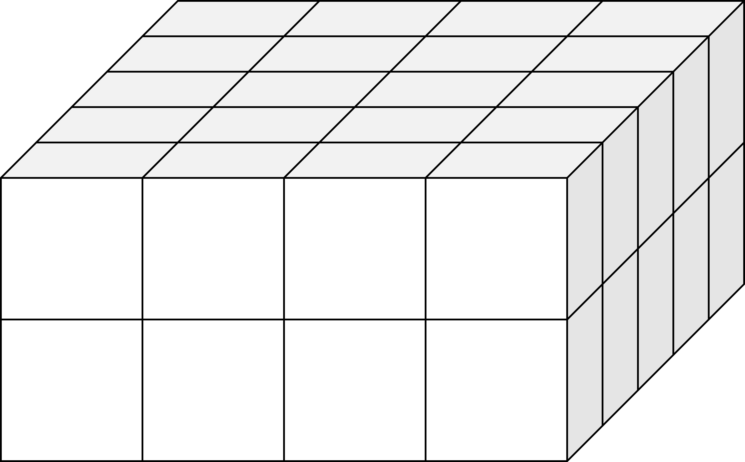
Experiments
60M
6M
1M
100k
10k
50x
Write
Read
1
2
4
8 CPUS
Notes:
1 CPU, 2 CPU, 4 CPU, 8 CPU
10K, 100K, 1M, 6M, 60M rows
Read and Write
50 times each

Slide 13

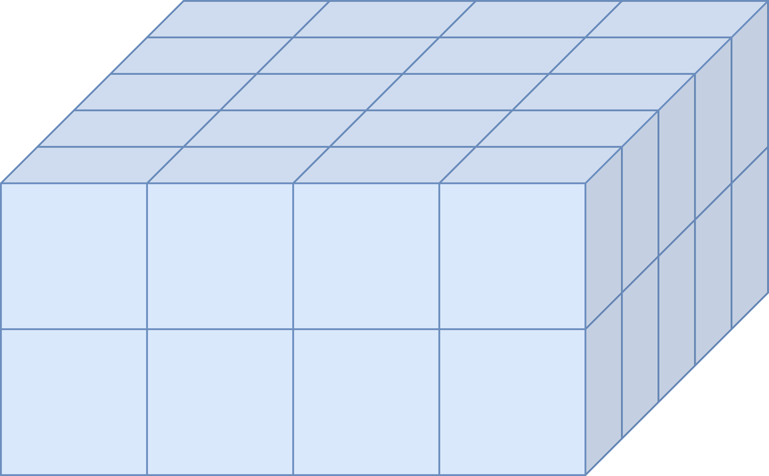
Experiments
Legacy
IcedHops
Notes:
1 CPU, 2 CPU, 4 CPU, 8 CPU
10K, 100K, 1M, 6M, 60M rows
Read and Write
50 times each

Slide 14
Takeaways - Write
Legacy
IcedHops
delta-rs
50s – 45min
+10% on 2 CPUs
0.7s – 34s
+0% on 2 CPUs
1s – 24s
+5% on 2 CPUs
0.02s – 22s
+40% on 2 CPUs
1s – 3min
+25% on 2 CPUs
0.05s – 23s
+50% on 2 CPUs

Slide 15
Takeaways - Read
Legacy
IcedHops
delta-rs
50s – 45min
+10% on 2 CPUs
0.7s – 34s
+0% on 2 CPUs
1s – 24s
+5% on 2 CPUs
0.02s – 22s
+40% on 2 CPUs
1s – 3min
+25% on 2 CPUs
0.05s – 23s
+50% on 2 CPUs

Slide 16
Takeaways
IcedHops
40-140x write
55%-60x read
Best in 88% tests
delta-rs
6-40x write
45%-40x read
Best multi-core
scalability
Legacy
Slowest in 100% tests

Slide 17
Research questions
RQ1: possible to integrate IcedHops?
Notes:
Jumping back to the beginning. The research questions delineated while starting this project were:
Which are the difference for read and write latency and throughput, between:
The legacy system and IcedHops
IcedHops and the delta-rs system
Now, given the results and their analysis, we can draw our conclusion.

Slide 18
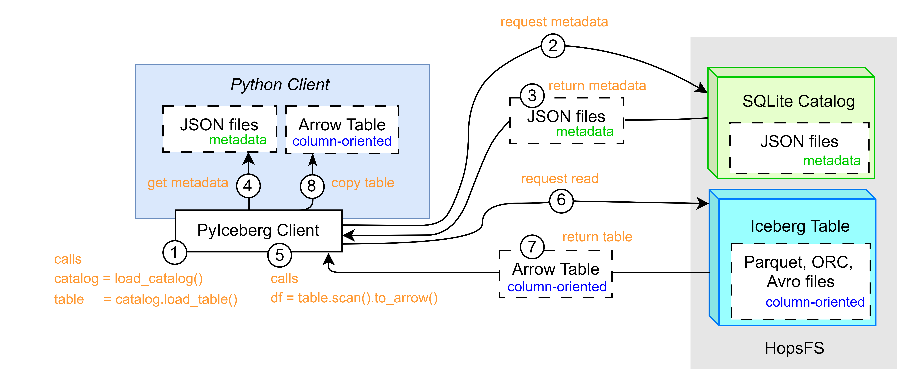
Research questions
RQ1: possible to integrate IcedHops?
Notes:
Jumping back to the beginning. The research questions delineated while starting this project were:
Which are the difference for read and write latency and throughput, between:
The legacy system and IcedHops
IcedHops and the delta-rs system
Now, given the results and their analysis, we can draw our conclusion.

Slide 19
Research questions
Conclusions
Differences in read and write latency and throughput between:
RQ2: legacy system and IcedHops.
RQ3: IcedHops and the delta-rs system.
IcedHops fulfils all the system requirements.
This solution can be preferred over the legacy system.

Slide 20
Research questions
Conclusions
Differences in read and write latency and throughput between:
RQ2: legacy system and IcedHops.
RQ3: IcedHops and the delta-rs system.
IcedHops on 1 CPU performs equally or faster than delta-rs.
IcedHops higher integrability, maintainability,and supports more file format.
The solution could be preferred to delta-rs, for small-scale scenario in 1-4 CPU settings.
Notes:
In 4+ cores solutions, on read operations, this could slightly change. In this case, should also be considered that the difference between writing and reading latency is more balanced in the IcedHops system, thus the choice should also depend on the envisioned amount of write/read operations ratio.

Slide 21
Limitations
Future works
Time
Computation
Scope
Larger datasets
Different data format/storage
Different feature store
New APIs
New table formats
Notes:
The findings and limitations of this thesis open multiple avenues for future research. Relaxing one or more constraint or limitation, could provide further insight and generalize this thesis finding across broader applications. Future works should investigate:
Larger datasets (1BN, 10BN). This should determine whether there’s a threshold where a Spark-based system outperform the alternatives described in this thesis
Keeping the same table format but looking at different data formats (AVRO,ORC) or cloud storage solutions (S3, GCS, Azure)
Same technology outside of Hopswors feature store, such the feature stores offered by Databricks or Feast
Use new libraries of the current OTFs, such the emerging iceberg-rust, for better local resource management or multi-cores performances
OTF still in their first stages, such as Apache Paimon.

Slide 22



PoliMi Supervisor:
Davide Martinenghi
EIT Digital Coordinator:
Federico Schiepatti
KTH Examiner & Supervisors :
Vladimir Vlassov
Fabian Schmidt
Sina Sheikholeslami
THANKS!
Company Supervisor:
Davit Bzhalava - Hopsworks
Family & Friends 🥰
22

